Slide 1
Using Python with Topspin
Why Python?
What is & isn't possible
Pitfalls
Tips & tricks / workarounds
Real-life example: automatically run efp on all one-dimensional data

Slide 2
What I won't tell you
General tutorial in how to use Python
  Would take too long
  Available from several other places (UCS, python.org website, elsewhere on web)
Generating pulse programs with Python
  I haven't needed to do this myself

Slide 3
What is Python?
Named after Monty Python
Interpreted (not compiled) language (“script”)
Aims for code readability & re-use
Features that cause pitfalls with Topspin + Python:
  Leading whitespace (space vs tab) is significant
  Pass-by-reference

Slide 4
Why Python?
Allows automating tedious tasks
Easier & quicker than C ('AU' programs)
  Python has a more complete standard library
  Python does not require type declarations
  Many AU commands risk causing buffer overruns
Record of what you did last time

Slide 5
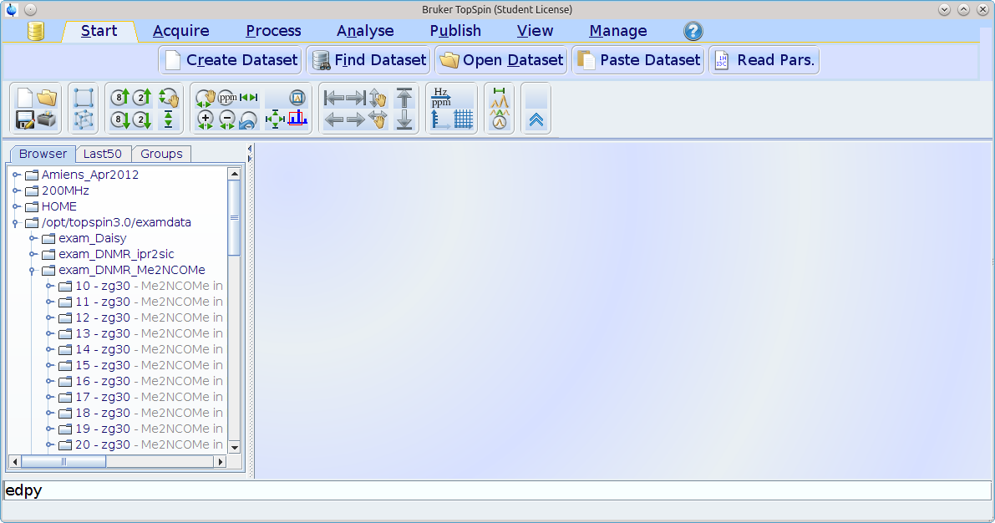
Getting started (1)

Slide 6
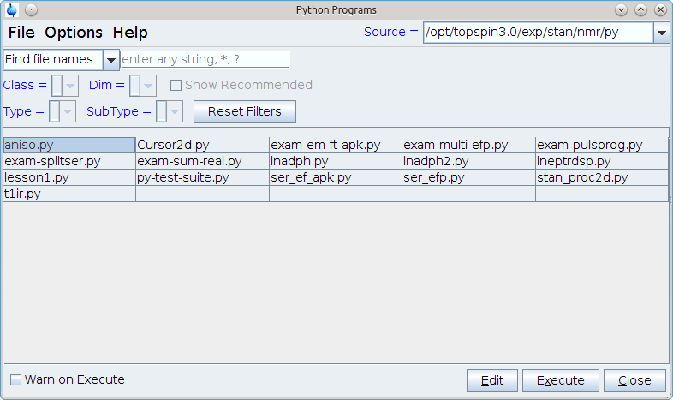
Getting started (2)

Slide 7
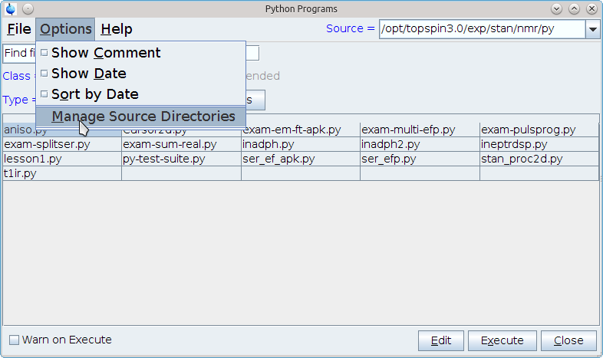
Getting started (3)

Slide 8
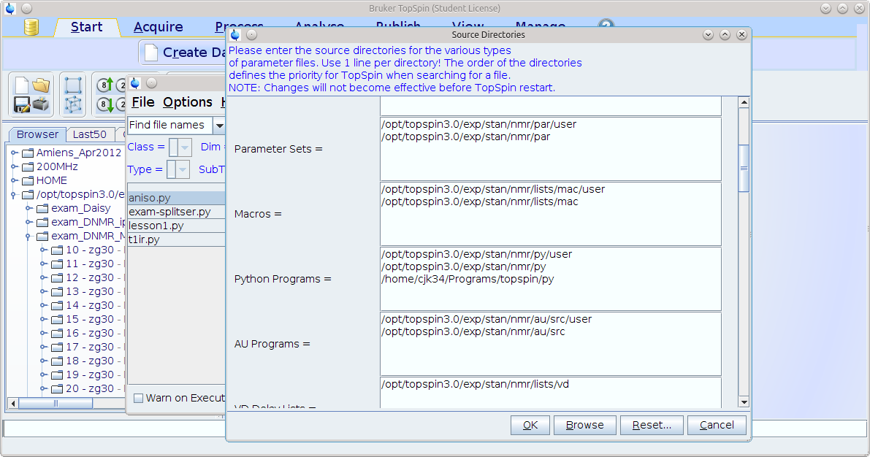
Getting started (4)

Slide 9
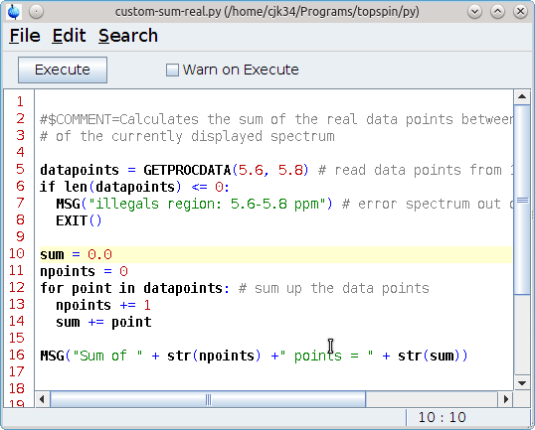
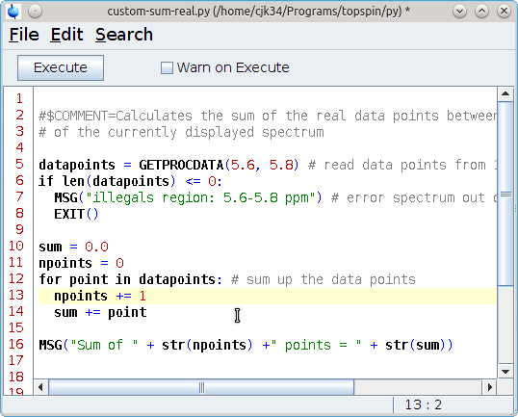
Whitespace problems (1)
Spot the difference between the two script files...
Incorrect
Correct

Slide 10
Whitespace problems (1)
Spot the difference between the two script files...
Here!
Incorrect
Correct

Slide 11
Whitespace problems (2)
Default indent in the topspin editor is tab
Default indent in code distributed with Topspin is two spaces
Editor displays a tab as two spaces
Confusing errors!

Slide 12
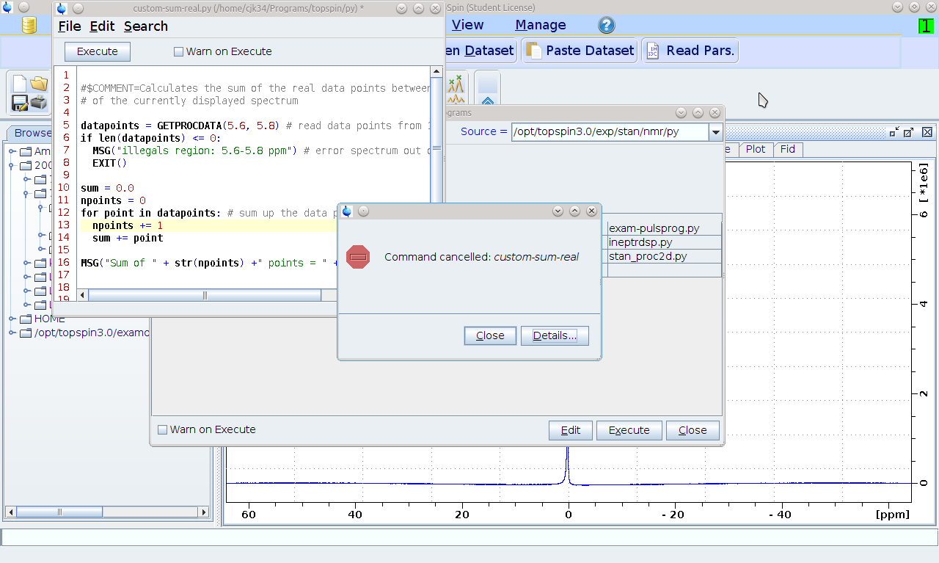
Whitespace problems (3)

Slide 13
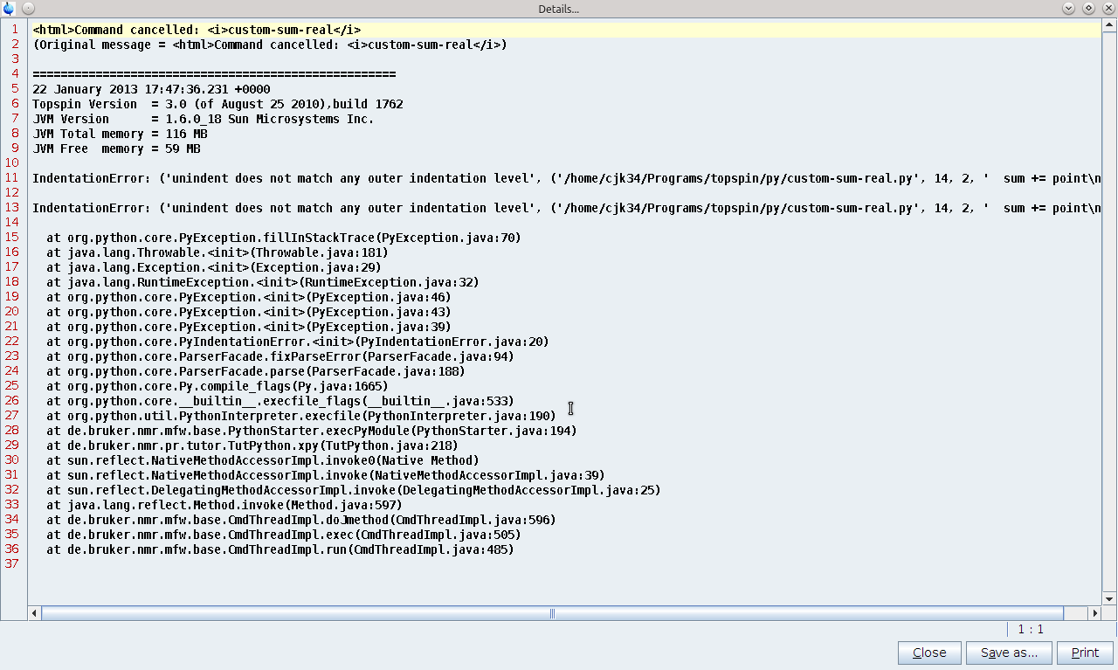
Whitespace problems (4)

Slide 14
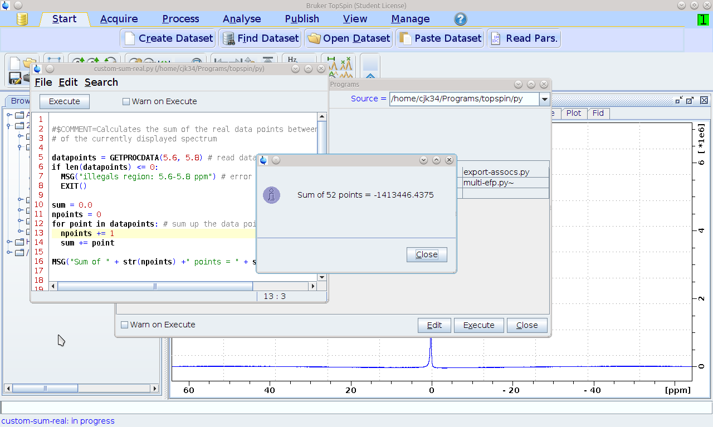
Whitespace problems fixed...

Slide 15
Pass / copy by reference
Every variable in Python is a reference
Can't tell the difference for immutable data
For mutable data structures (lists etc.) this can give surprising results

Slide 16
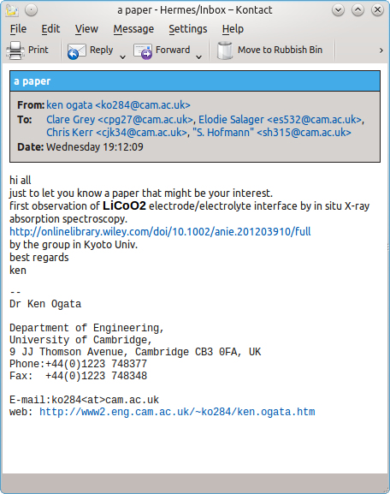
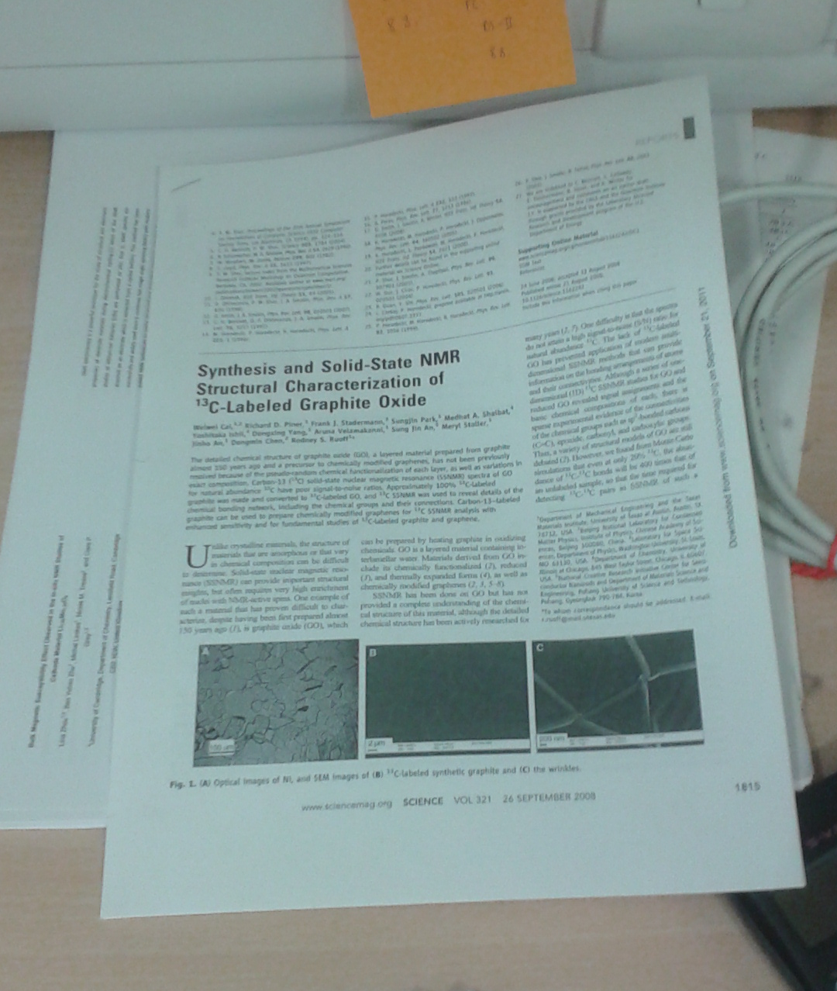
Reference vs Value (immutable)

Slide 17
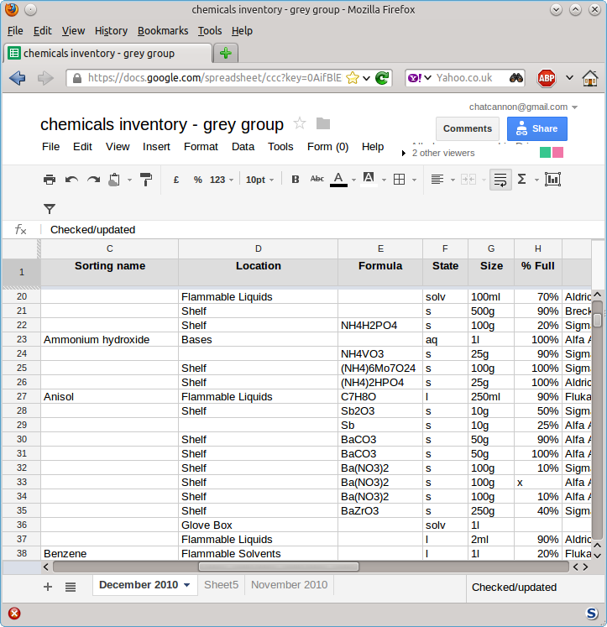
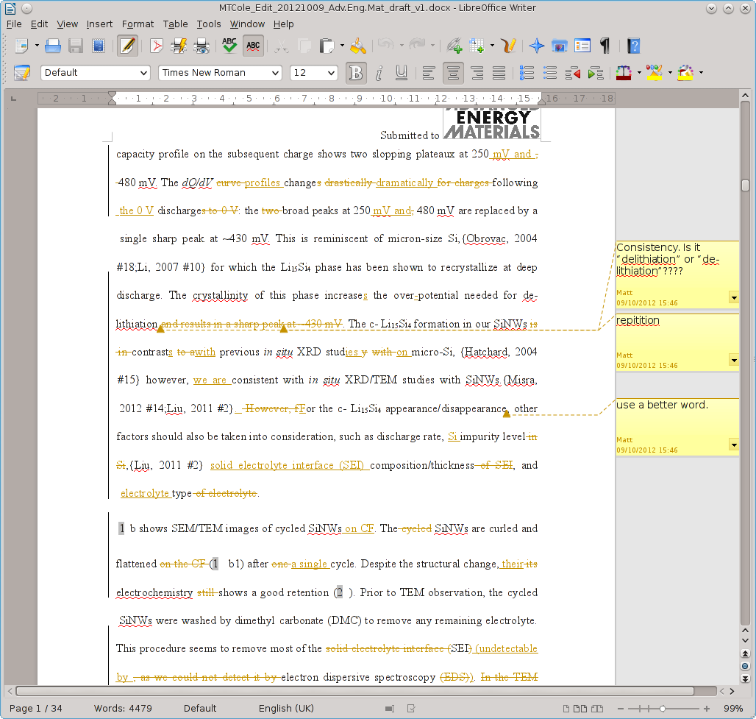
Reference vs Value (mutable)
Reference: Google Docs
Value: Word Document attachment

Slide 18
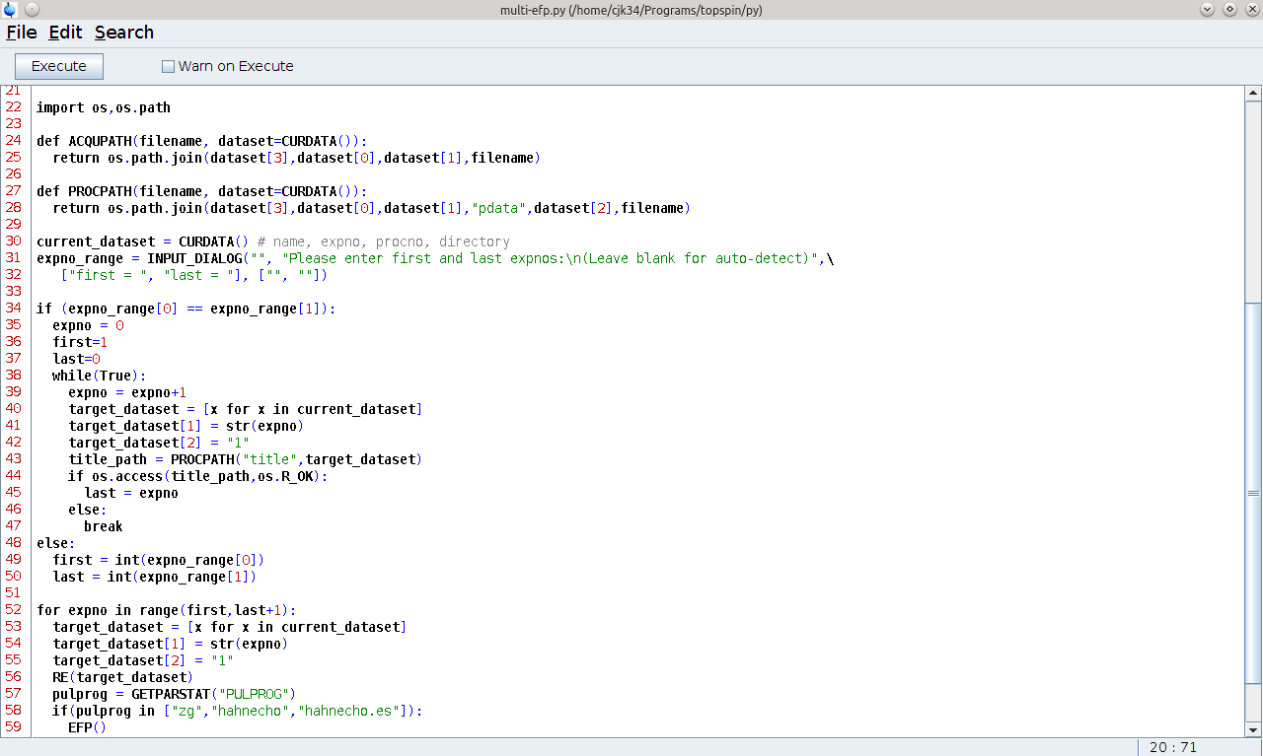
Workaround – deep copy

Slide 19
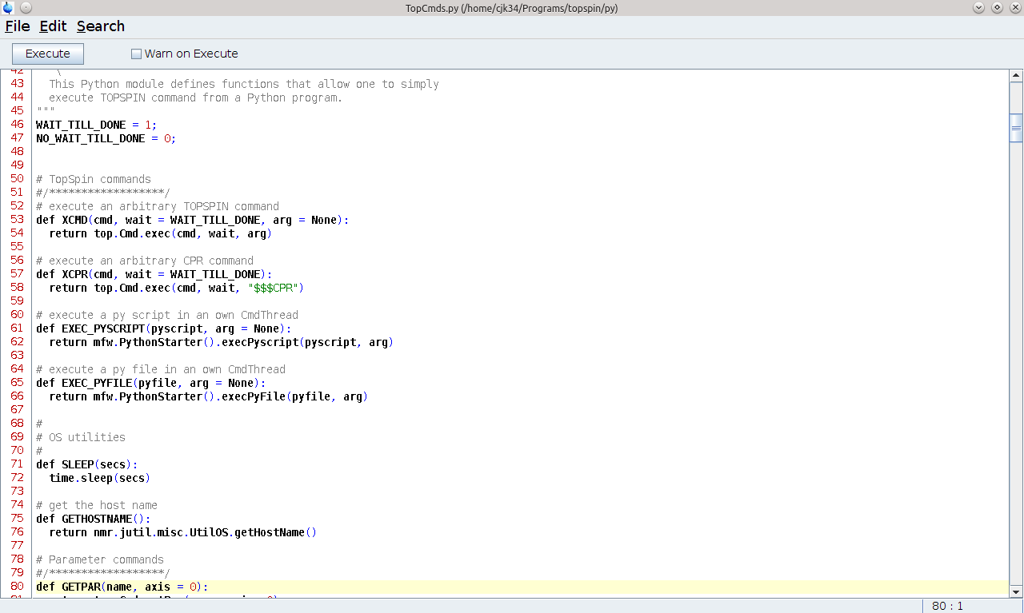
Tips & tricks 1 – look in TopCmds.py

Slide 20
Tips & Tricks 2 – text files in exp folder

Slide 21
More info about Python
Online tutorial at Python website
  http://docs.python.org/2/tutorial/
UCS courses
  http://www.training.cam.ac.uk/ucs/search?query=Python
Download (to use Python outside Topspin)
  http://www.python.org/download/

